Slide 1
Climate Change
Khoi Duong

Slide 2
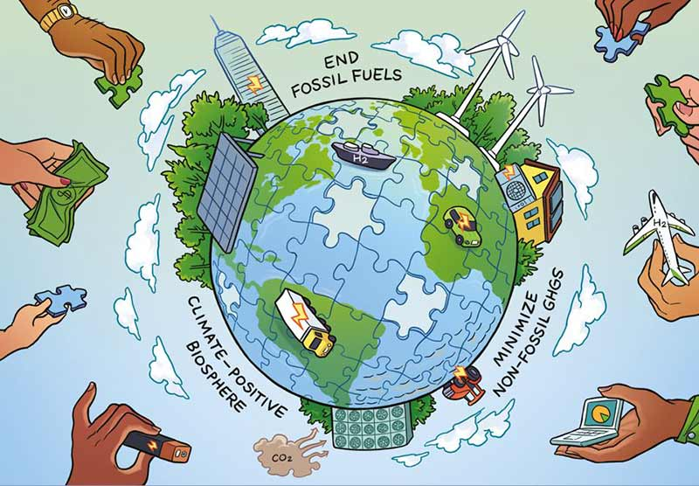
Project Motivation
Climate change is a looming issue
Potentially catastrophic global consequences
Major economies affected by natural disasters
Damage expenses potentially costing billions in taxpayer money annually

Slide 3

Background Information On Climate Change
Earth’s Ozone Layer Depletion
Paris Climate Accords adopted in 2015
1.5℃ or less from the average prior to pre-industrial times (1850 Average: 14.87℃)
Temperature Danger Threshold: 16.37℃

Slide 4
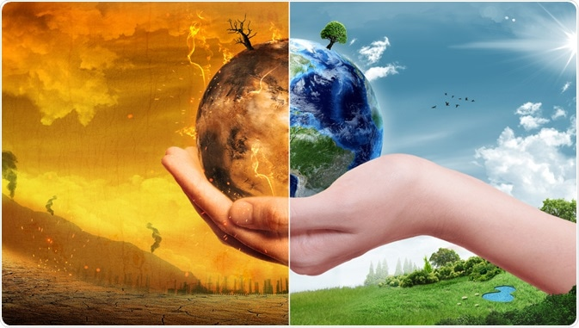
Research Question
When will Earth’s temperatures rise to concerning levels (16.37℃) for all global societies?

Slide 5
Research Process
Determine Country Population/Emissions Relation To Global Temperature
Perform Machine Learning To Forecast (Prophet)
Find Data Sources
1
3
5
2
4
6
Clean/Merge Data Sources On Jupyter
Linear Regression Models
Analysis Findings & Conclusions

Slide 6
Sources
Temperature Data Source: https://www.kaggle.com/berkeleyearth/climate-change-earth-surface-temperature-data#GlobalTemperatures.csv
Country Emissions Per Capita Data Source: : https://ourworldindata.org/grapher/co-emissions-per-capita?tab=chart&country=AUS+CAN+USA+OWID_WRL PPM - https://ourworldindata.org/co2-and-other-greenhouse-gas-emissions - For Machine Learning Model.
Population Data Source: https://population.un.org/wpp/Download/Files/1_Indicators%20(Standard)/EXCEL_FILES/1_Population/WPP2019_POP_F01_1_TOTAL_POPULATION_BOTH_SEXES.xlsx

Slide 7
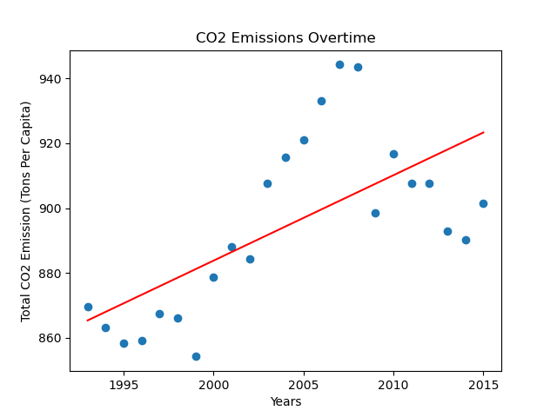
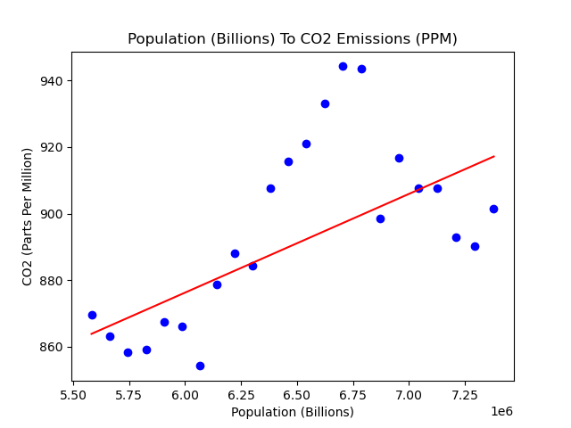
${CO}_{2}$ Emissions

Slide 8
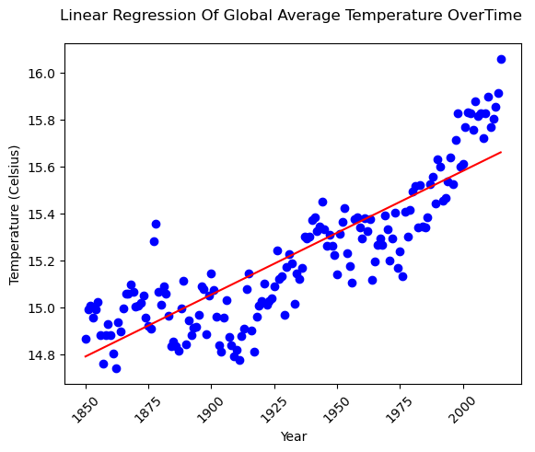
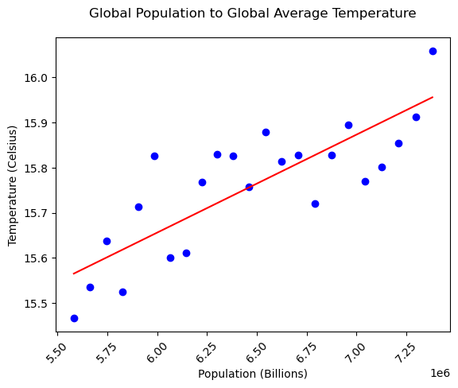
Temperature Rise Relation Overtime/Population Rise

Slide 9
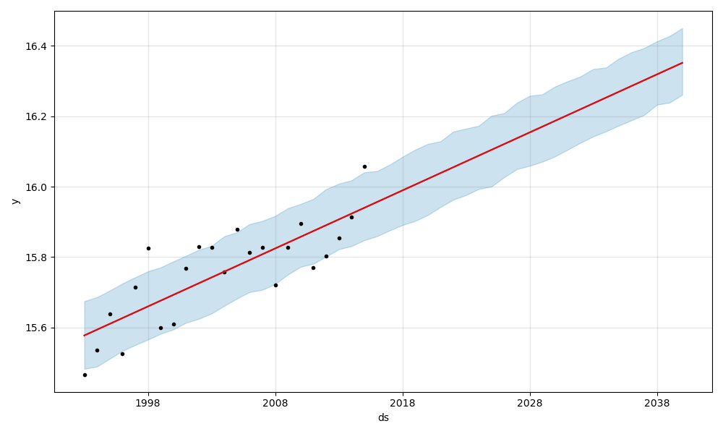

Machine Learning Prediction
Danger temperatures of 16.37℃, or 61.47℉ reached by 2038
Used
Facebooks’ open-source multivariate prediction that uses a simple, modular regression model.

Slide 10
Data Summary & Analysis
Temperature threshold will be reached by 2038

Slide 11
Thank You
Any Questions?

